Slide 1


Bouncing Bugs
Mehmet Faik
Marco Lamb
Stephen Kidner
Team Members:

Slide 2
Concept
The aim of Bouncing Bugs is to gain all of the Lady Birds spots back against the clock.
Setting
Bouncing Bugs is set from the perspective of a Lady Bird making its way around vast forests.

Slide 3
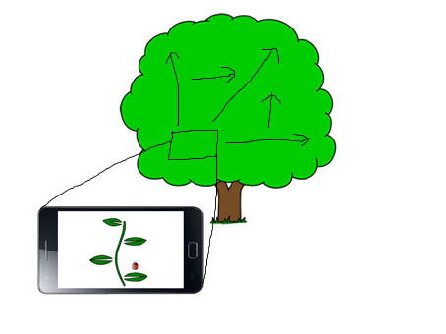
Game Structure

Slide 4
Players
The game is single player based on one device.
Action
Players will control the lady bird bouncing from leaf to leaf exploring the world around them, against the clock

Slide 5
Objective
The objective of Bouncing Bugs is to collect as many of the ladybirds spots as possible within the given time limit.
Target System
Bouncing Bugs will be produced for Android smart phones and tablets.

Slide 6
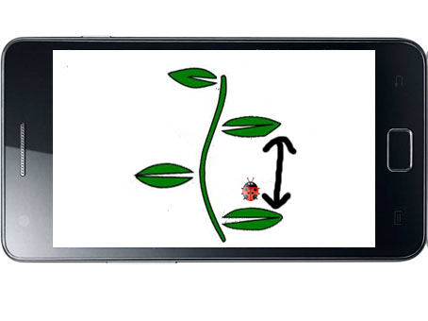
Game Play

Slide 7
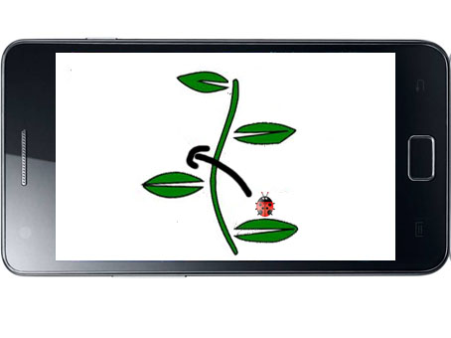

Slide 8
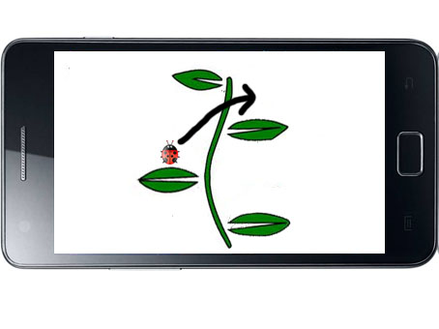

Slide 9
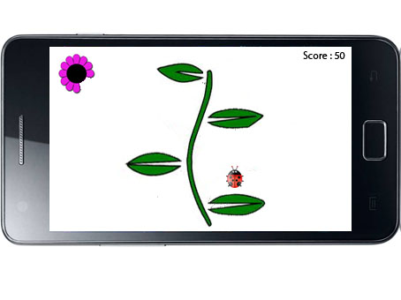
Scoring and Timer

